Slide 1
JK Flip-flop

Slide 2
JK Flip-flop
Due to the undefined state in the SR flip flop, another flip flop is required in electronics. The JK flip flop is an improvement on the SR flip flop where S=R=1 is not a problem.
The input condition of J=K=1, gives an output inverting the output state. However, the outputs are the same when one tests the circuit practically.

Slide 3
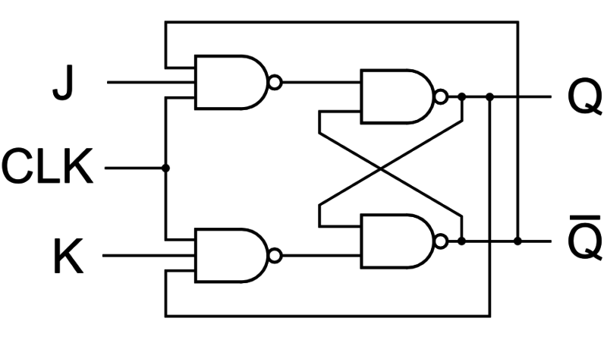

Slide 4
In simple words, If J and K data input are different (i.e. high and low) then the output Q takes the value of J at the next clock edge. If J and K are both low then no change occurs. If J and K are both high at the clock edge then the output will toggle from one state to the other. JK Flip Flop can function as Set or Reset Flip flop.

Slide 5
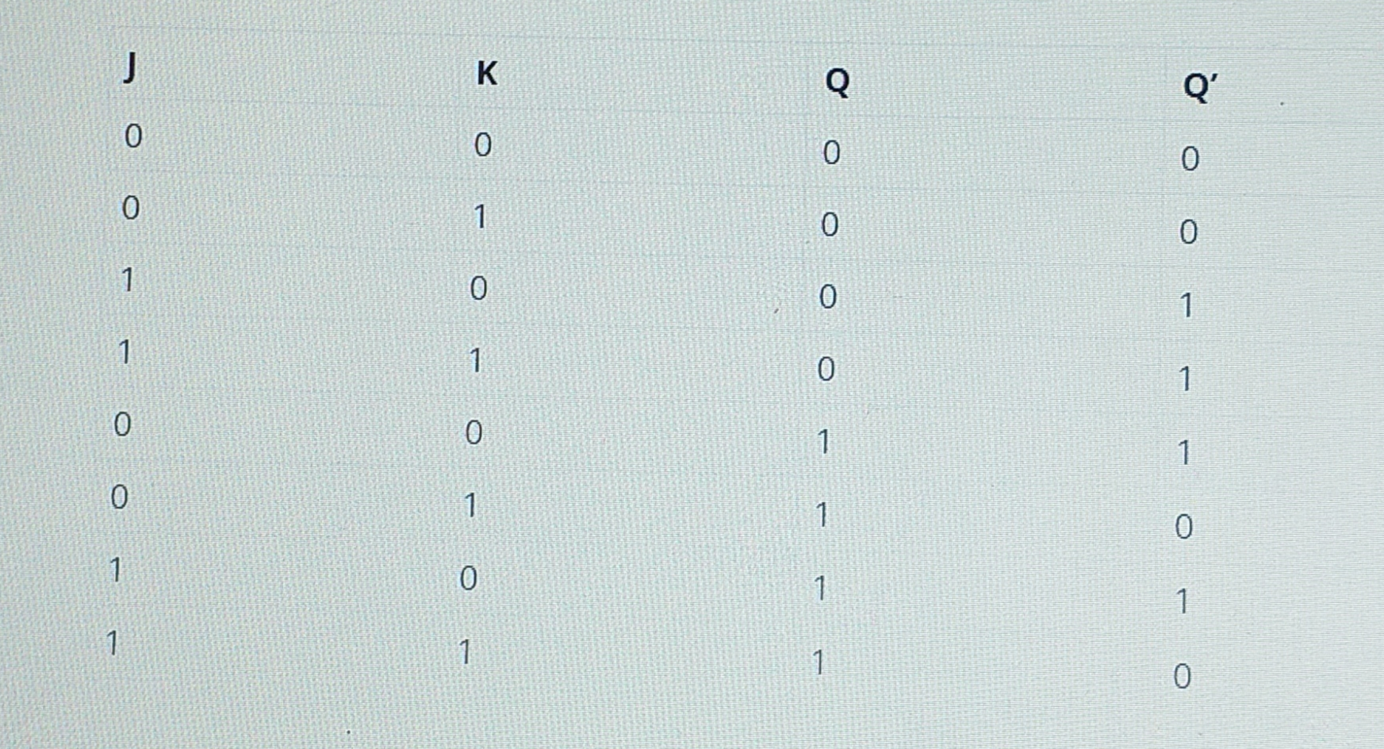

Slide 6
D Flip Flop
D flip flop is a better alternative that is very popular with digital electronics. They are commonly used for counters and shift-registers and input synchronization.
The change of state of the output is dependent on the rising edge of the clock. The output (Q) is same as the input and can only change at the rising edge of the clock.

Slide 7
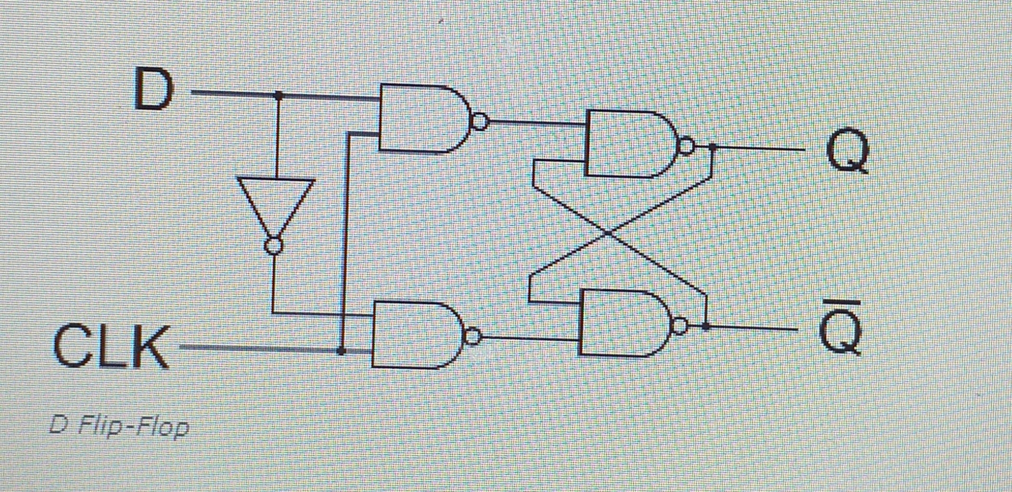

Slide 8
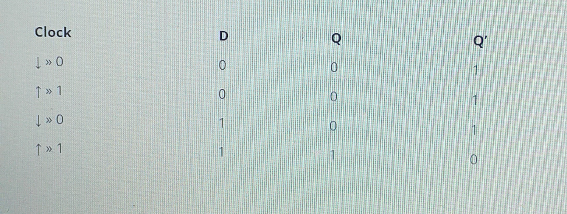

Slide 9
T Flip Flop
A T flip flop is like JK flip-flop. These are basically a single input version of JK flip flop. This modified form of JK flip-flop is obtained by connecting both inputs J and K together. This flip-flop has only one input along with the clock input.

Slide 10
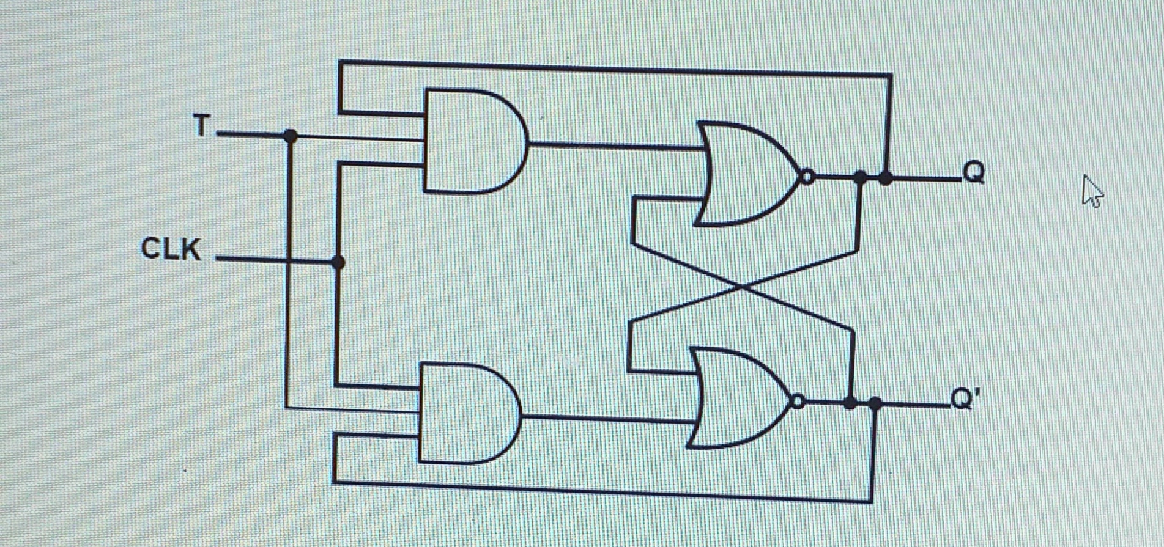

Slide 11
These flip-flops are called T flip-flops because of their ability to complement its state (i.e.) Toggle, hence the name Toggle flip-flop.

Slide 12
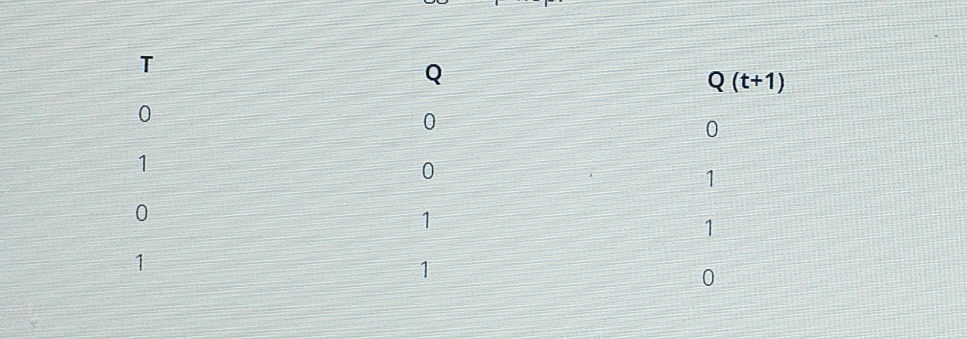

Slide 13
Applications of Flip-Flops
These are the various types of flip-flops being used in digital electronic circuits and the applications of Flip-flops are as specified below.
Counters
Frequency Dividers
Shift Registers
Storage Registers

